Slide 1

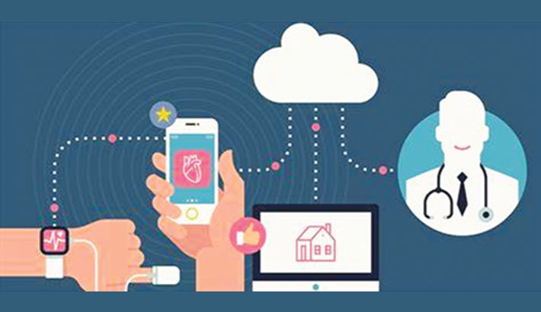

IoT Health Monitoring System

Slide 2


Overview
Introduction
Our Team
About us
Problems
ESP32
Raspberry PI
Node Red
Conclusion

Slide 3
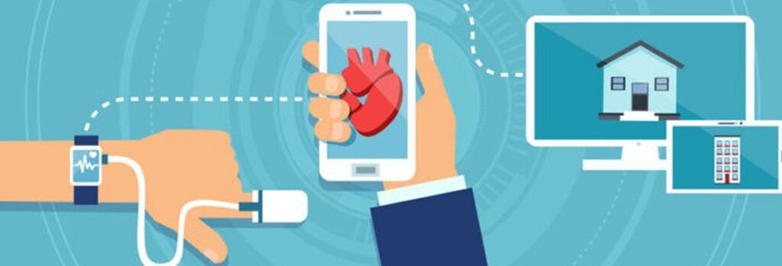
Introduction
An IoT health monitoring system uses connected devices to gather and transmit health data in real-time. In this setup, an ESP32 microcontroller collects sensor readings and sends them via MQTT to an MQTT server. A Raspberry Pi, subscribed to the data, processes the readings and takes actions based on specific conditions, such as activating a camera. Captured images and data are then displayed on a Node-RED dashboard, allowing for real-time monitoring and response. This system enhances healthcare by enabling continuous, automated tracking of health metrics.

Slide 4






Our Team
Alaa Hamed
Helmy Ahmed
Abdulrahman Mohamed
Marwa Moniem
Yusuf Borham
Abdelrahman Mahmoud

Slide 5
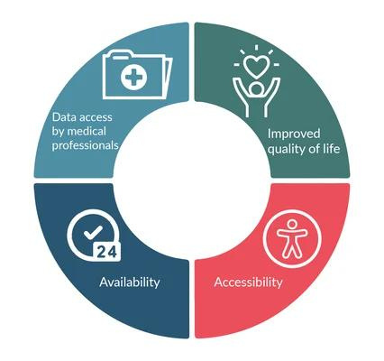
About us
We are a passionate team of innovators, engineers, and problem-solvers driven by a shared goal of leveraging technology to improve lives.
With diverse expertise in IoT, software development, and systems integration, we work together to create smart solutions that address real-world challenges.
Our team thrives on collaboration, creativity, and a commitment to pushing the boundaries of what’s possible. United by a dedication to excellence, we believe in the power of teamwork to deliver impactful, meaningful results.

Slide 6
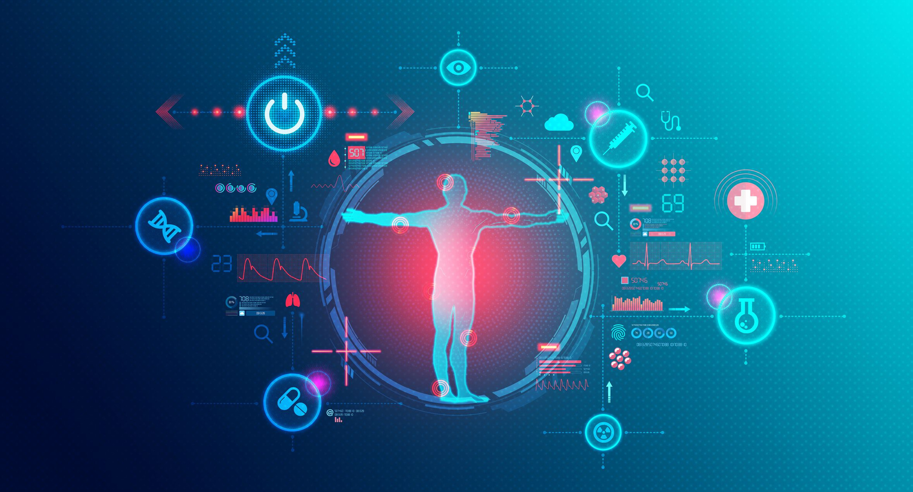
Problems
During the COVID-19 pandemic, the need for continuous, remote health monitoring became crucial, especially for high-risk individuals. Traditional systems often fail to provide real-time data and timely responses, making it difficult for healthcare providers to track patients' health remotely. This project aims to address these challenges by developing an IoT-based system for automated health monitoring, enabling real-time data transmission and quick response actions, reducing the need for in-person contact while ensuring patient safety and timely care.
Problem 01
Problem 02
Problem 03
How can we make the device small enough for the patient to carry with them and integrate a camera so that we can monitor the patient from a distance? Additionally, how will the camera be able to detect if the patient has fallen or fainted?
What type of sensor will we use, how will it be integrated into the system, and what are the normal values for a healthy human, such as heart rate and temperature
How can we visualize the readings and the photo of the patient in a way that is easy to understand for any user, not just doctors

Slide 7


ESP32
sensor connestion & publish it to mqtt server

Slide 8
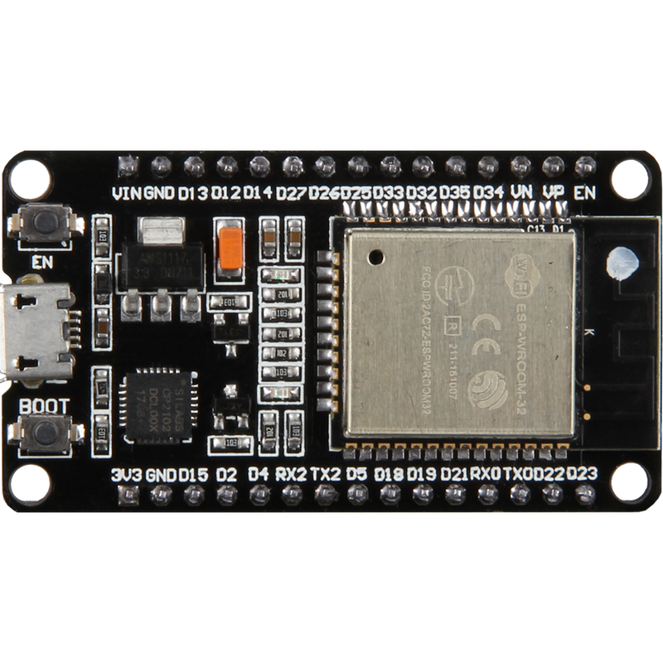
ESP32 connection
-We used esp32 to provide an analog to digital
convert
-All sensor are connected to it and it hang on paitent’s wrist like watch
-It publishes all sensor readings to an MQTT server

Slide 9
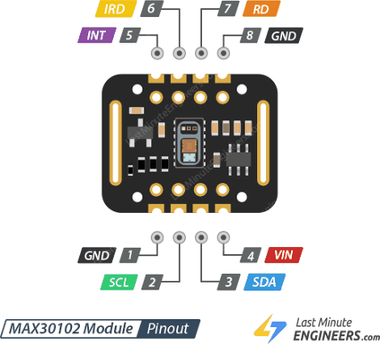
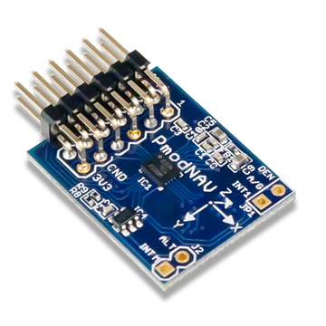
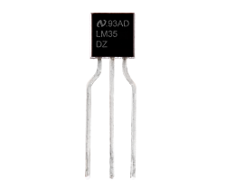
MAX30102
-Used to measure heart rate and oxygen saturation in blood
sensors
IMU
-Used to measure the acceleration and the amplitude in Z-axis to determine if patient fall or not
LM35
-Used to measure body temperature

Slide 10
RASPBERRY PI
connected to Raspberry Pi Camera and speaker

Slide 11
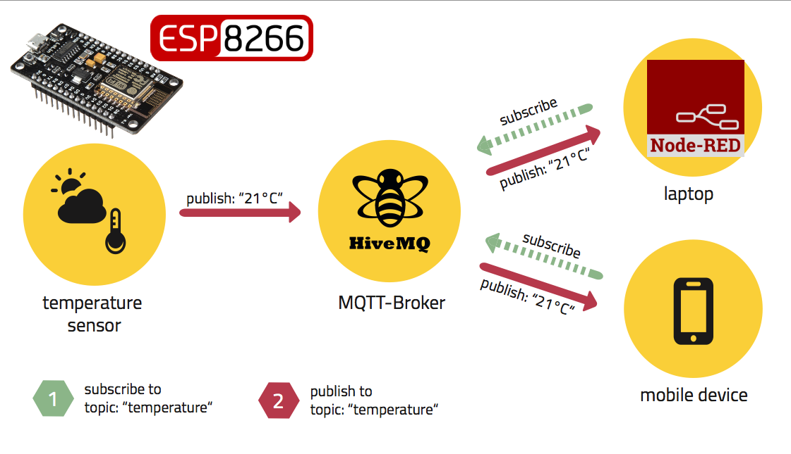
hivmq Broker
Sensor Data Publishing:
The ESP publishes sensor data to the HiveMQ broker, enabling real-time data transmission.
2. Raspberry Pi Subscription:
The Raspberry Pi subscribes to the broker, receiving and processing the sensor data for further actions.
PUBLI

Slide 12

Automatic Capture on Emergency Events:
The camera automatically takes snapshots when an emergency reading is received via the HiveMQ subscription.
01
Raspberry Pi Camera
Integration with Node-RED via HiveMQ:
The camera is connected to Node-RED through the HiveMQ broker, enabling real-time communication and control.
02
Manual Snapshot Triggering:
Users can manually trigger the camera to take a snapshot through the Node-RED dashboard.
03
Remote Visualization:
All captured images are sent to Node-RED for remote visualization, allowing real-time monitoring from anywhere.
04

Slide 13



Speaker System
Real-time Sensor Data Evaluation
Alert Mechanism
Emergency Response
The code is designed to continuously monitor sensor readings from a system that tracks patient health metrics. It collects data from multiple sensors, including heart rate and oxygen levels (via the MAX30102 sensor), motion and orientation (via the IMU sensor).
Based on the sensor data, the code determines whether the patient’s condition is safe or unsafe. In the event of an unsafe condition, the code triggers an emergency response by sending an alert message and activating an alarm sound
the system can quickly alert healthcare providers when a patient’s vital signs indicate a potential emergency. This allows medical staff to take immediate action,

Slide 14
NODE RED
The UI and visualization of sensor readings

Slide 15

Node-RED’s Role :-
Data Acquisition
Visualization
Integration
Receives sensor readings
Processes data streams
Triggers alerts when needed
Manual image shots
Displays real-time data
Provides interactive dashboards
Display real-time imge
Connects to various devices
Facilitates data exchange
Customizable workflow

Slide 16
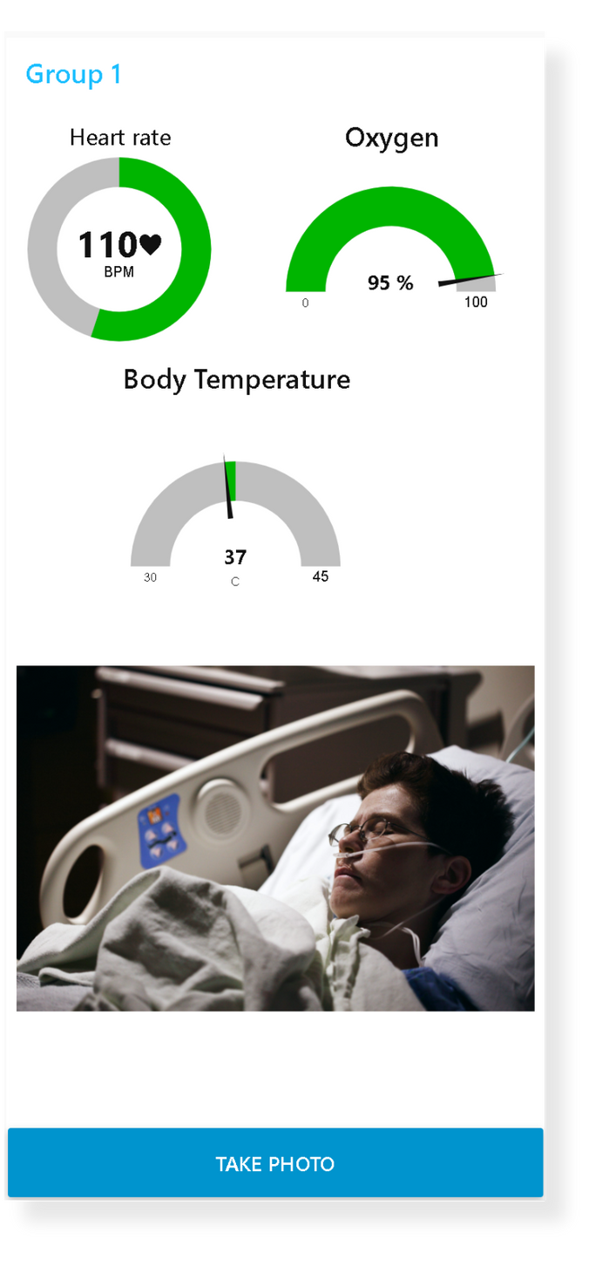
User Interface
An easy-to-use and clear interface that allows doctors and regular users to check on their patients without interacting with them
Heart Rate Monitoring :
A gauge that visualizes heart rate sensor readings.
Oxygen Saturation Level :
A gauge that visualizes oxygen in blood precentage
Body Temperature :
A gauge that visualizes body temperature in Celsius
Patient Monitoring:
A real-time photo of the patient taken when the sensor readings are abnormal or by manual capture if necessary.

Slide 17
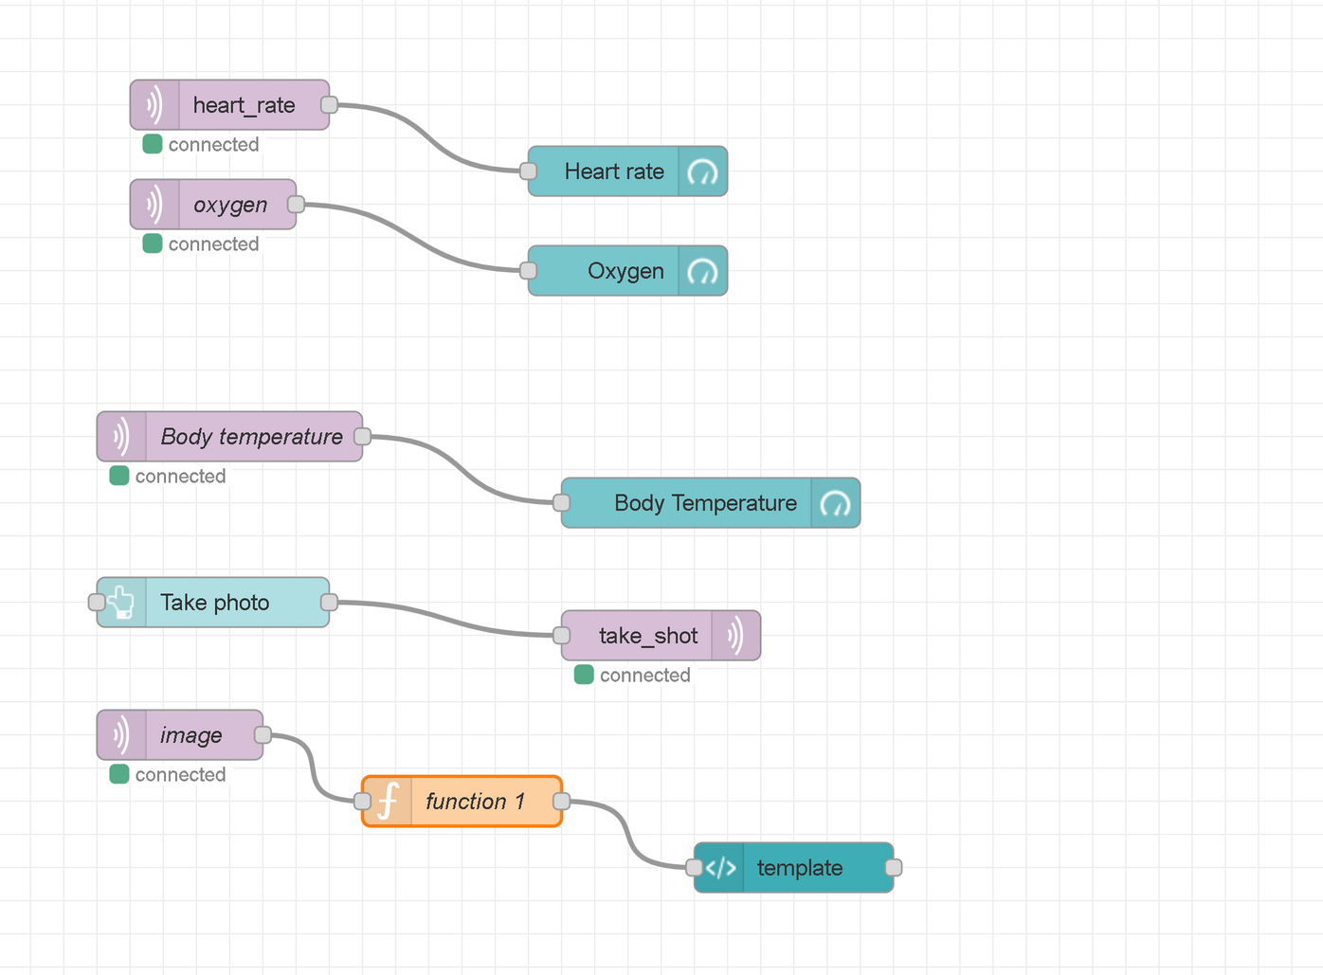
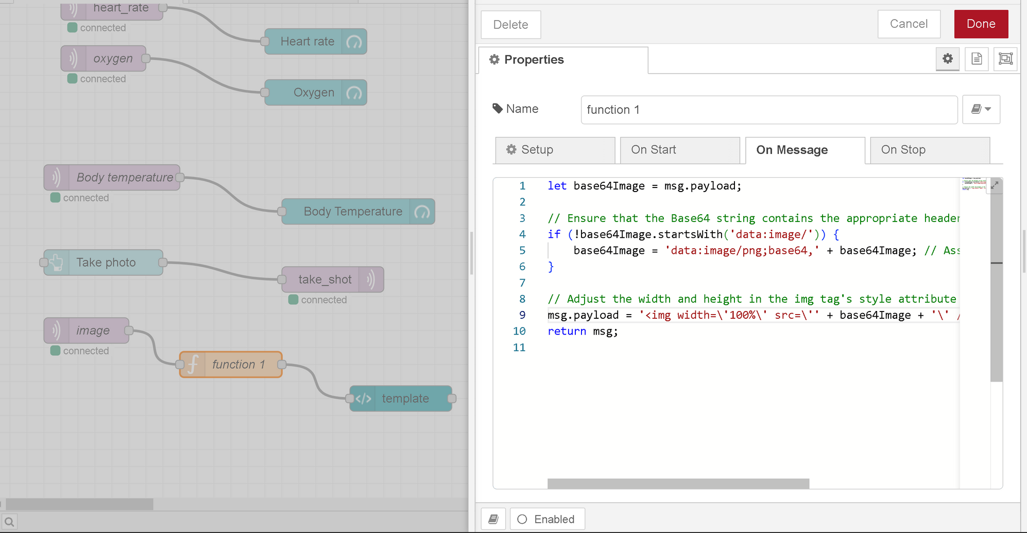
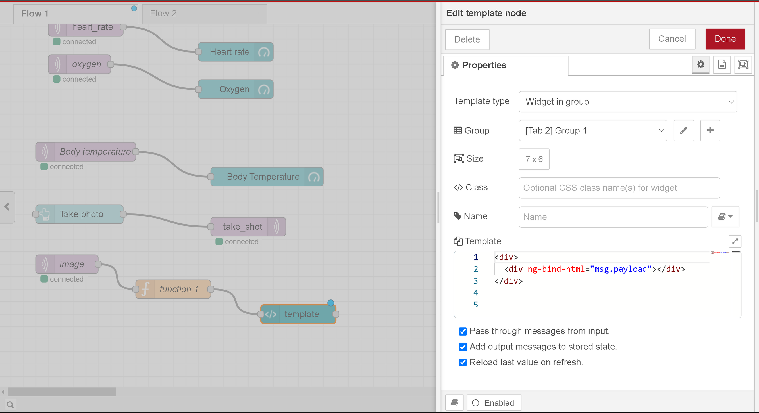
Node Red Flow
-MQTT in node used to subscribe to the
sensor readings topic
-MQTT out node used to publish manual
capture signal
-The image received from MQTT server encoded as base64
and this function decoded it to image
-The template node uses HTML code to
display image in dashboard

Slide 18
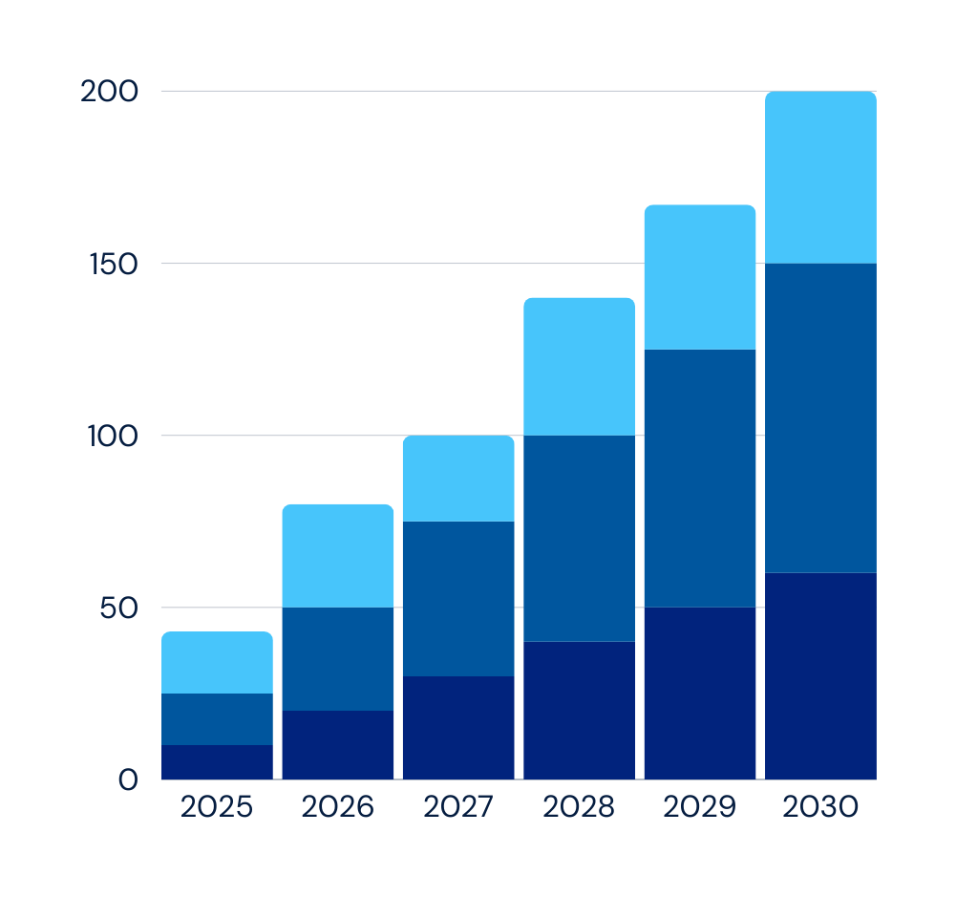
Remote patient monitoring (RPM) are set to transform the healthcare industry in several ways over the coming years:
Early Detection & Prevention:
Continuous monitoring for early detection of health issues.
Enhanced Chronic Disease Management:
Better management of chronic conditions like diabetes and hypertension.
Reduced need for frequent hospital visits.
Cost-Effectiveness:
Lower healthcare costs for patients and systems.
Real-Time Emergency Alerts:
Immediate alerts for critical conditions.
Faster emergency response and medical intervention.
80%

Slide 19


THANK YOU!

